Slide 2
Officers 101
Knights of Columbus
Texas State Council

Slide 3
You have been Elected an Officer of your Council , Congratulations!!!! Now What?!?!
You have demonstrated various Leadership skills to get elected to your honored position
You must understand your part in this machine, which is our great Order
Your task is to lead your Council to the highest honor for a Council – “Star Council” (The Goal)
You must work with the other Officers for the Council to reach the Goal
You must help implement the plan to reach the Goal
You must reassess and make changes necessary to your plan to reach your Goal

Slide 4
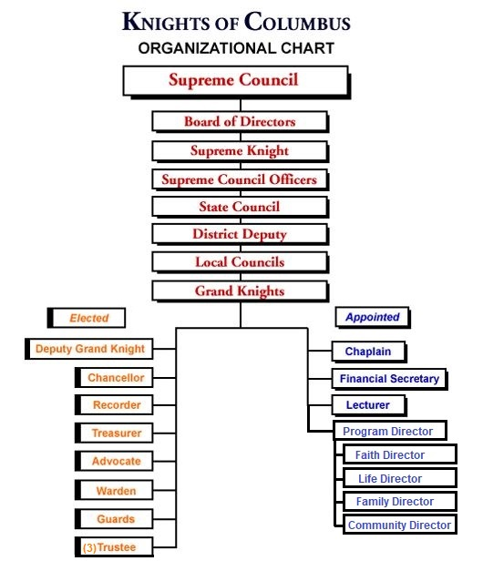

Slide 5
Why local Officers are so Important
Nothing in the Order happens without the work of the local Council
The results of the local Council affects the District, Diocese, State, & Supreme Results
All new members come from the local Council
All programs originally came from a local Council

Slide 6
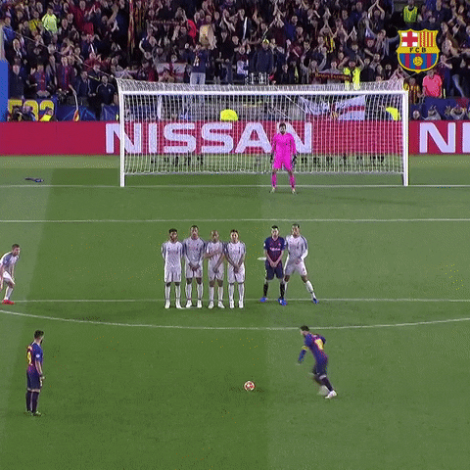
Star Council
The goal - Star Council
Star Council encompasses:
Membership Growth, Insurance Growth, Active Programs, & providing the required reports
Notes:
Add Gif of someone scoring a goal.

Slide 7
Star Council Requirements
Membership Growth – Fr. McGivney Award
Insurance Growth – Founder’s Award
Submit the following reports on time:
Report of Service Personnel – Form 365 – Due June 30
Annual Survey of Fraternal Activity - Form 1728 – Due January 31
Columbian Award Application (form SP-7) due June 30
Complete the SAFE Environment Requirements by May 1

Slide 8
Father McGivney Award
Membership Growth Requirement is 6% minimum of 5 up to a maximum of 15
A council that is not growing is dying

Slide 9
Founder’s Award
Each Council must market & host a minimum of (2) Fraternal Benefit Nights
The Knights of Columbus Insurance Program is the best in the business

Slide 10
Star Council Requirements
Report of Service Personnel – Form 365
This report names all the appointed positions – Program Director, Chaplain, Membership Director, Faith Director, Life Director, Family Director, Community Director, Retention Chairman, etc. Due by June 30 each year.
Each must have an individual Email address for the Safe Environment Training – including the Grand Knight.

Slide 11
Star Council Requirements
Annual Survey of Fraternal Activity – Form 1728
Due by January 31 each year
Columbian Award Application – Form SP-7
Due by June 30 each year

Slide 12
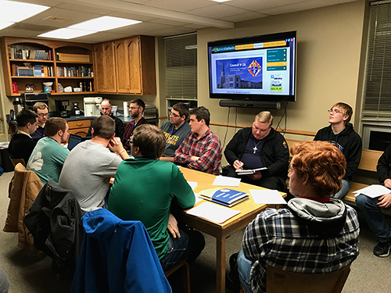
Star Council Requirements
How do you get there? PLAN!
1st know your Membership Goal
2nd Plan the 2 Fraternal Benefit Nights
3rd Schedule your programs

Slide 13
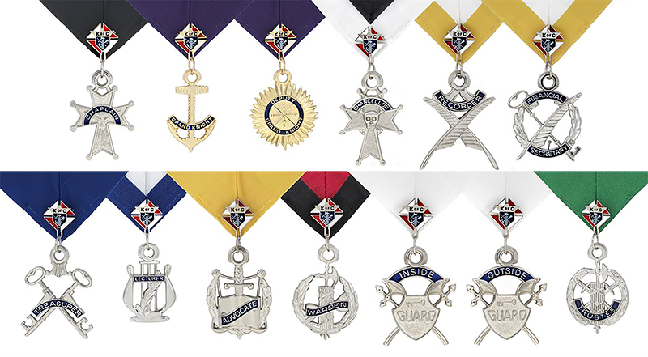
The Officers

Slide 14
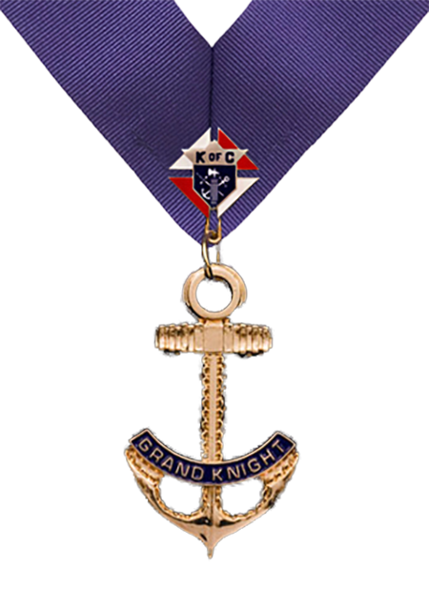
Grand Knight
The CEO of the council
Meet with his Priest often
Stay in constant contact with officers & members
Be in contact with your District Deputy at least monthly outside the Council Meeting.

Slide 15
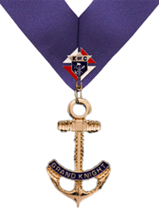
Grand Knight
Must complete Form 365 by August 1
Must be Safe Environment Trained by May 1
Attend Diocesan Conferences & District Meetings
Attend webinars for Training
Attend the Annual State Convention

Slide 16
Grand Knight
Annual Council Planning Meeting June, after the council elections
Council Budget, be prepared to approve in July
Communicate your plan to the council

Slide 17
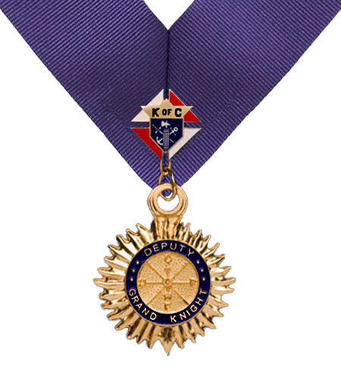
Deputy Grand Knight
Typically, is the Program Director
If Program Director, must be Safe Environment Trained
Attend, with the Grand Knight, Diocesan Conferences & District Meetings
Be prepared to fill in if the Grand Knight is absent
Verify that the Fraternal Program Report – Form 10784 is completed for all activities

Slide 18
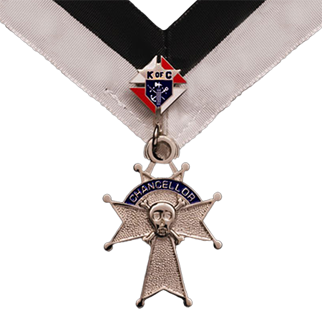
Chancellor
Responsible for new member engagement
Be prepared to fill in if the Grand Knight and Deputy Grand Knight are absent
Help to recruit and retain members

Slide 19
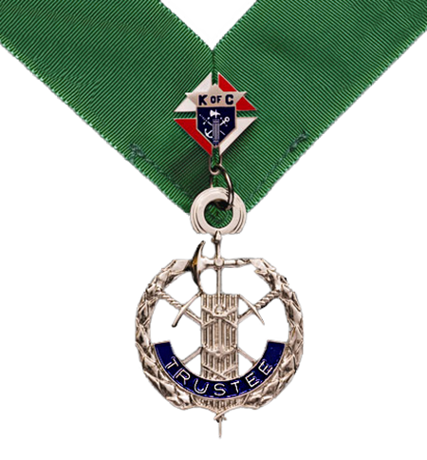
Trustees
Must conduct the Semiannual Council Audit Report – Form 1295 twice a year.
1st one due August 15 for January – June of previous fraternal year.
2nd one due February 15 for July- December of the current Fraternal Year
Must be an active part of the Retention Process
Help track progress towards Star Council

Slide 20
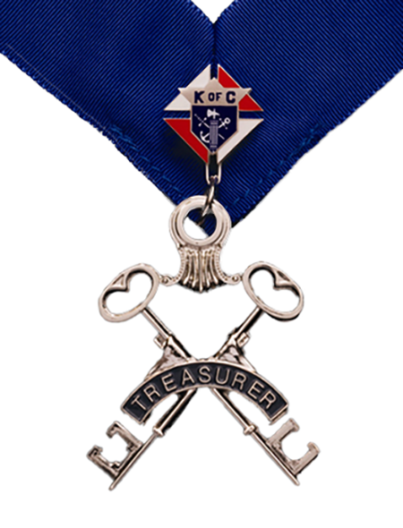
Treasurer
Council check writer
Give receipts to the Financial Secretary
Reconcile all bank statements
Must prepare the books for the (2) Audits
Attend all Council Meetings including the Officer & Director’s Meeting.

Slide 21
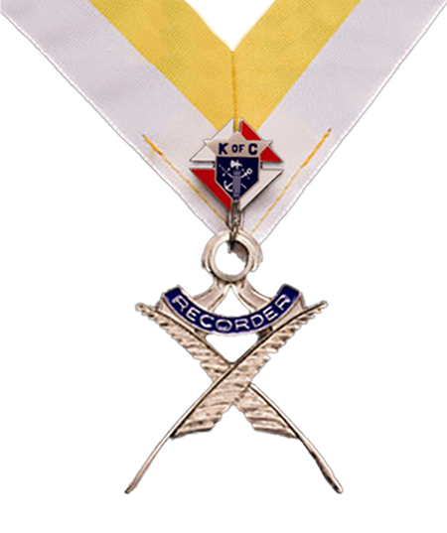
Recorder
Attend all Council Meetings including the Officer & Director’s Meeting
Keep proper meeting minutes of all Council Meetings
These minutes are used as the history of the Council
Accurate minutes aid in completing the Form Sp-7

Slide 22
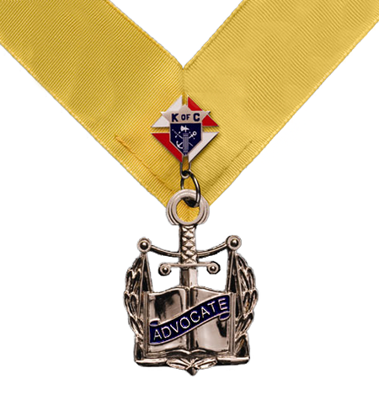
Advocate
Attend all Council Meetings including the Officer & Director’s Meeting
Parliamentarian for the Council
Have knowledge of the Council’s By-laws, the Orders Charter, Constitution, and Laws
Has access to the Officers Online and refer to the Officer’s Desk Reference for all questions
Knows who the State Advocate is

Slide 23
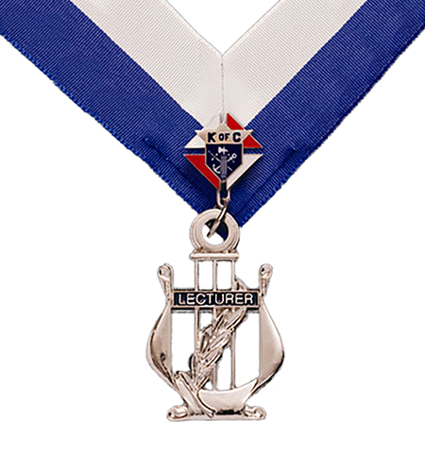
Lecturer
Attend all Council Meetings including the Officer & Director’s Meeting
Appointed by the Grand Knight
Give a brief Spiritual reflection during each meeting
Evangelization and Faith Formation and COR

Slide 24
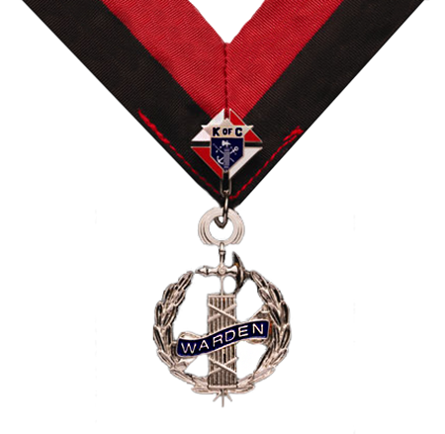
Warden
Attend all Council Meetings including the Officer & Director’s Meeting
Quartermaster of all Council Property
Ensures council chambers are properly arranged for meetings
Directs guards to check cards at Council Business Meetings
Be familiar with KofC protocols regarding high ranking guests

Slide 25
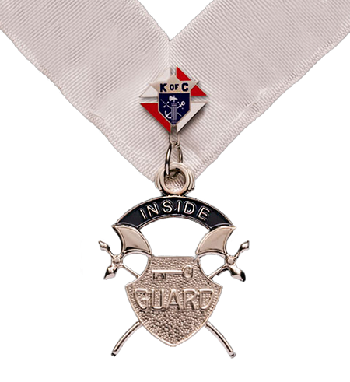
Guards
Attend all Council Meetings including the Officer & Director’s Meeting
Verify current membership cards for all attendees (except clergy)
Excellent opportunity for new Knights to become engaged as developing council leaders

Slide 26
Council Officers
All have access to Supreme’s Officer’s Online.
You can request login information from Supreme at 1-800-380-9995. You will need your Membership number, Council number, & your position. Verify your Council has filed the Report of Officers – Form 185 for the current year.
Visit the Supreme’s website frequently - www.kofc.org
Visit the State’s website frequently - www.tkofc.org.
Visit your Diocese’s website
Reach out to your fellow officers for help. Follow the chain of command listed earlier. Never be afraid to ask a question.
Work as a unit to accomplish the Council’s goal of achieving STAR COUNCIL!

Slide 27
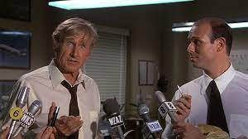
Questions???

