Slide 1
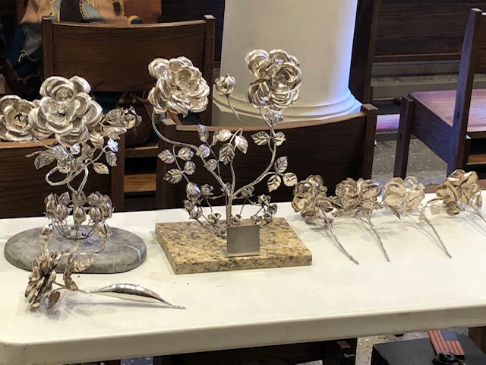
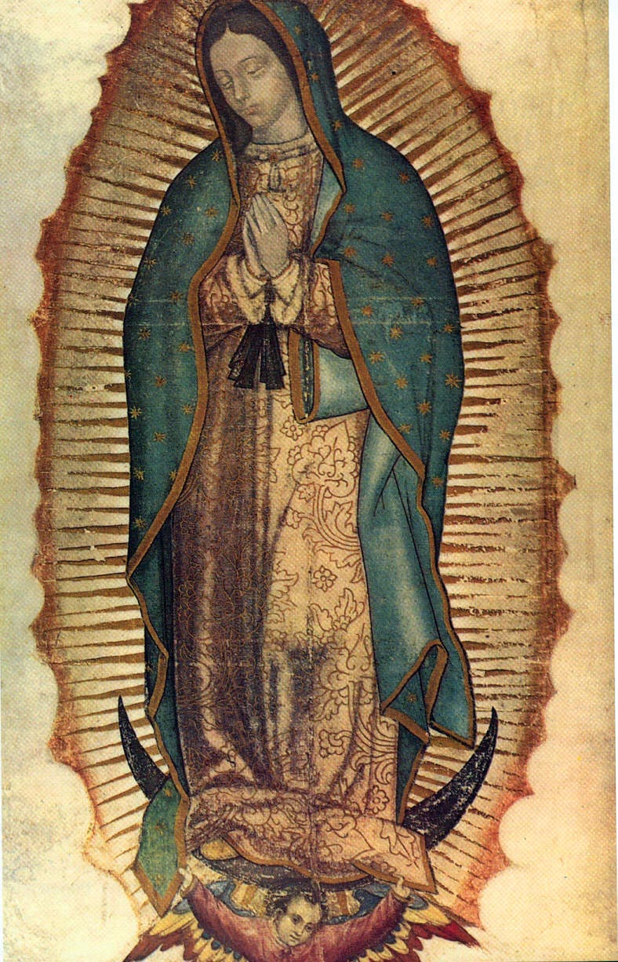
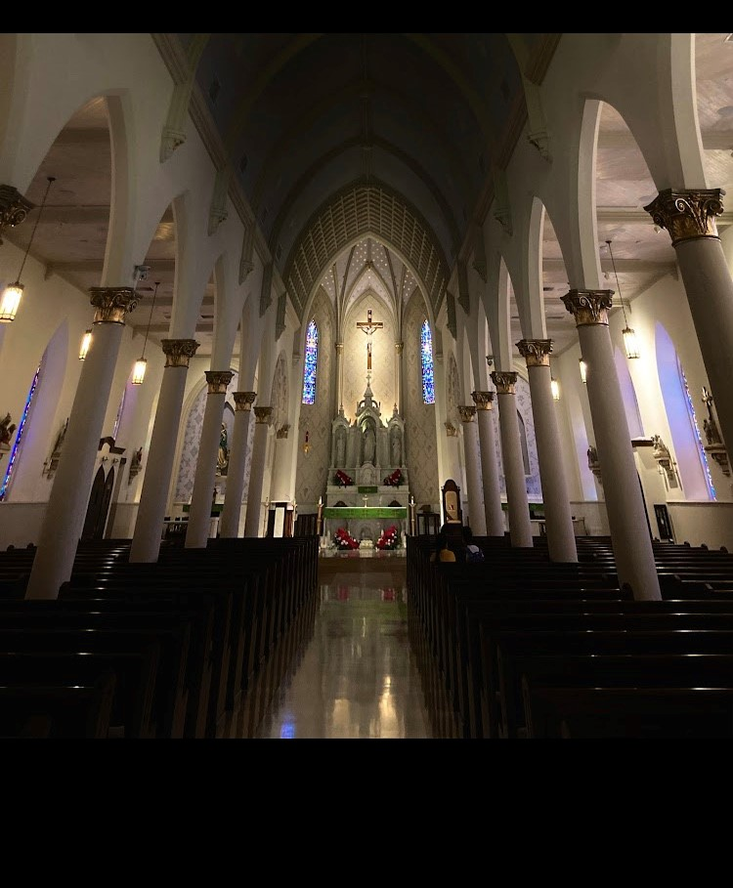
Silver Rose
“Come join us as we celebrate Our Blessed Mother – Our Lady of Guadalupe”
Silver Rose Social Dinner Dec.9 , 7 pm -11 pm
American Legion Post 59
809 Zaragoza St., Laredo Tx 78040
$200 table (seats 8) Presale Tickets
For Tickets call Alfred MaCabe 956-744-2304, Joe Ramos 956-286-2052 , Hector Chapa 956-285-36789
“International Silver Rose’ Mass
Dec. 10 , 12 noon
San Agustin Cathedral
201 San Agustin Ave, Laredo TX 78040
International Silver Rose Transfer Ceremony
Dec. 10 , 1pm
*Silver Rose Ceremony will be held at the center of the International Bridge crossing into Mexico.

